Slide 1

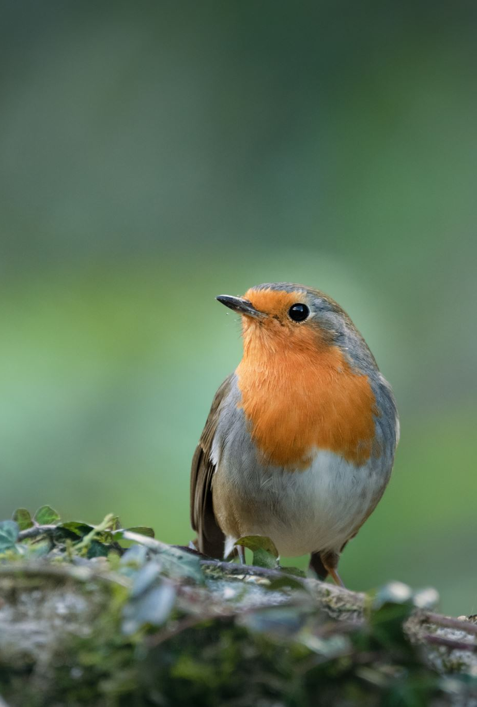
Assessing Avian Biodiversity at Cutacre Nature Reserve
A Comparison of Integrated Acoustic Monitoring and Field Survey Analysis
By Lucas-Roman Crawford, Charlie Hignett, Shealyn Horrocks, Noor Al-Ain Mirza, Cara Mullen, and Thomas Snelson

Slide 2
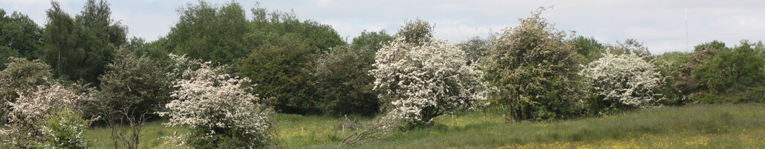
Background
Cutacre Nature Reserve is a rich wildlife site located on the Salford and Wigan borough borders in Greater Manchester.
The site was originally used for opencast mining, however these processes stopped in 2005, and restoration work has been done to restore the site and maintain habitats.
It is home to many different species, from the rare Willow Tit to Longhorn Cattle and the ponds have had Great Crested Newts found in them.

Slide 3
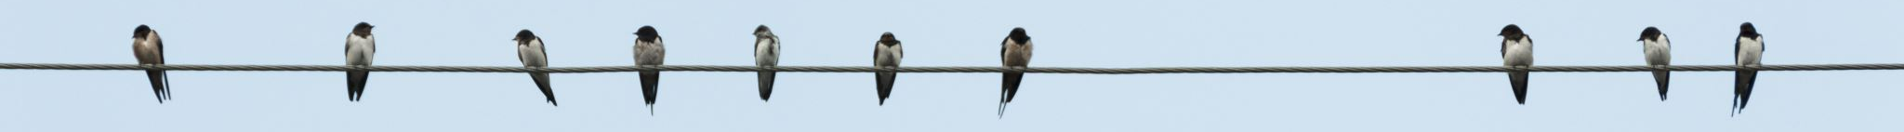
Where Do Canopy Consultants Come in ?
To Analyse Eco-Acoustic Data Using Automated Species Recognition Tools
To Integrate Acoustic and Field Based Datasets for Biodiversity Assessment
To Develop Evidence Based Management and Monitoring Recommendations
To Assess Population Trends Using the Common Bird Census Data

Slide 4
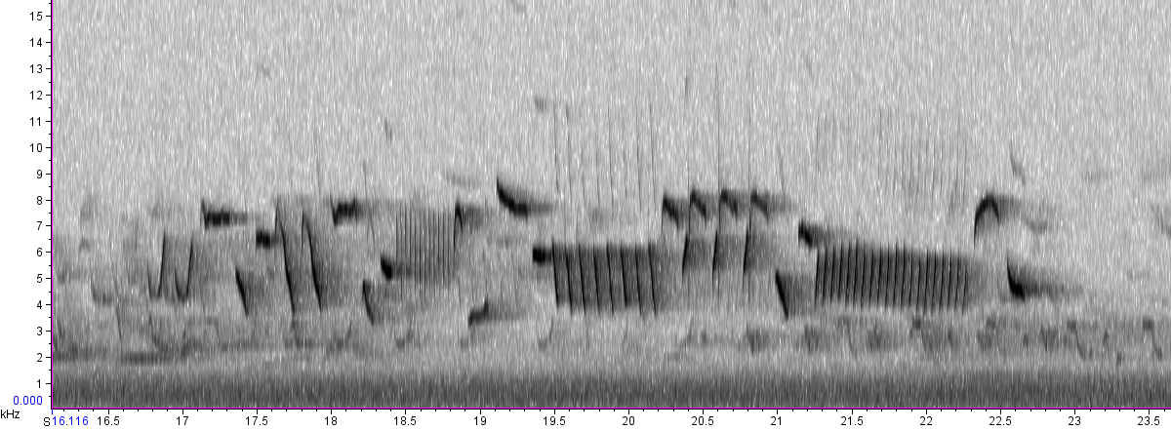
Methodology
Using data analysis to assess avian biodiversity by comparing bioacoustics monitoring data with the Common Bird Census (CBC) records.
Primary data collection had already been done so our focus was processing, analysing, and comparing existing datasets to meet the objectives.
Acoustic recordings collected between March and April 2025 will be processed using BirdNET and to improve reliability an appropriate confidence threshold was used.
The bioacoustics data and CBC data were compared to see how each method complements each other.

Slide 5
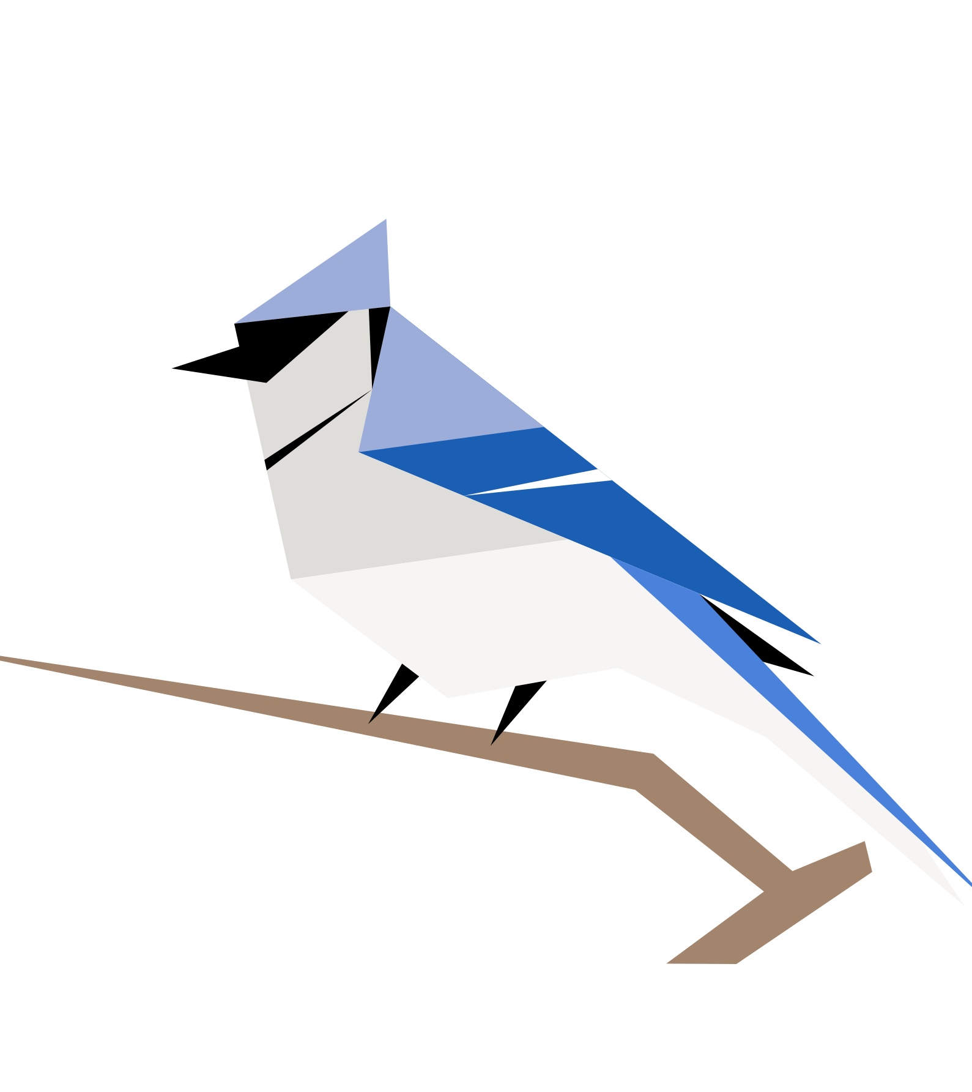
What Is BirdNET Analyzer?
BirdNET Analyzer is an AI-based tool used to automatically identify bird species from audio recordings.
Developed by the Cornell Lab of Ornithology in collaboration with Chemnitz University of Technology.
Uses machine learning algorithms trained on large global bird sound datasets.
Processes audio files (e.g. WAV) and outputs:
Detected species
Time stamps of detections
Confidence scores

Slide 6
Processes (Challenges/Limitations)
Strengths
Use of pre-collected CBC data allowed for efficient analysis without time-intensive fieldwork
Combination of acoustic data and species records provided a broader ecological perspective
Use of BirdNET Analyzer enabled rapid processing of large audio datasets
Acoustic monitoring reduces observer bias compared to traditional survey methods
Clear temporal overlap (March–April) allowed for direct comparison between datasets
Limitations
Lack of spatial data limited the ability to map species distributions across the site
Reliance on secondary data (CBC) may introduce inconsistencies in collection methods
Temporal mismatch (CBC: March–June vs recordings: Feb–April) restricts full comparison
Use of a single recorder may not capture the full diversity of the site
BirdNET misclassification risk, especially with background noise or non-bird sounds
Acoustic data may miss silent or less vocal species, leading to underrepresentation

Slide 7
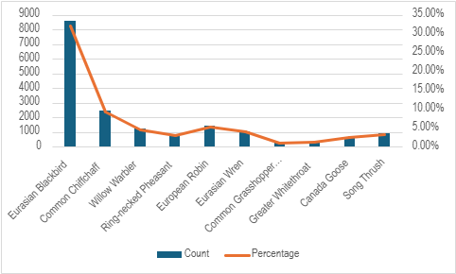
Findings

Slide 8
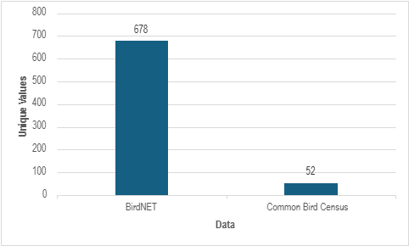

Slide 9
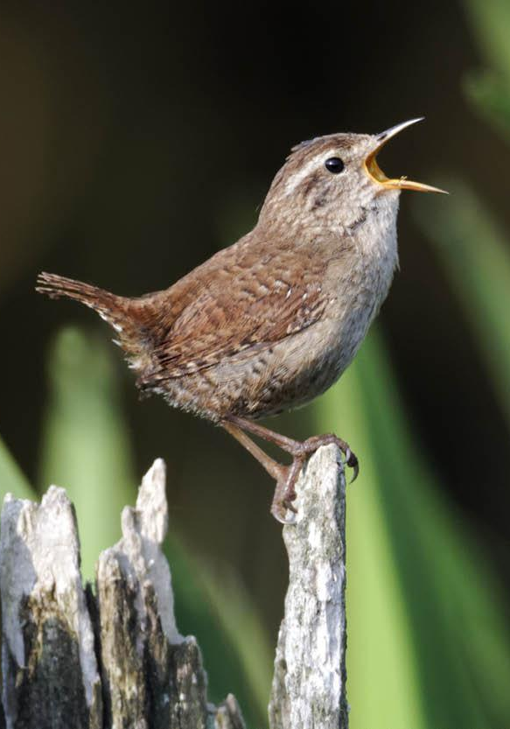
Recommendations
Collect acoustic and common bird census data over a longer period, rather than just using data from March 2025 and April 2025.
Introduce measures to the common bird census surveys to reduce observer bias and improve reliability when detecting a bird species.
Combine the data from BirdNET and the Common Bird Census, don’t just use one or the other.

Slide 10
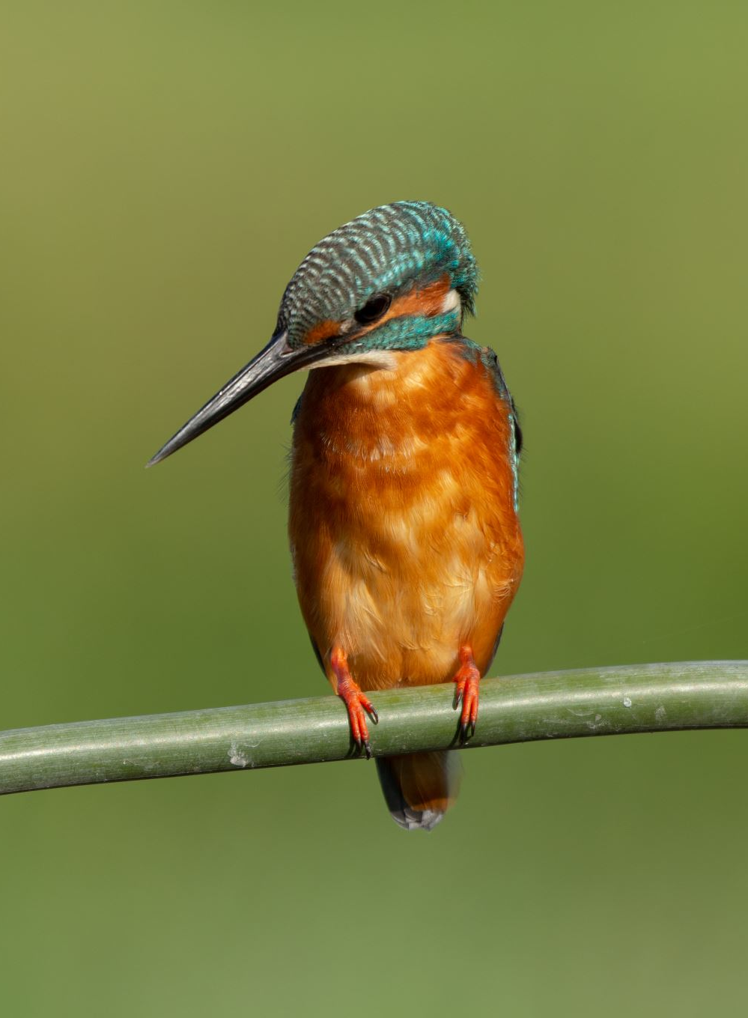
Acknowledgements
We want to thank Stephen Cartwright from the Lancashire Wildlife Trust for giving us the opportunity to work on this project and providing us with all the data for us to be able to do it.
We also want to thank our lecturers, Helen Whitehead and Thomas Smyth, for all their help and feedback that assisted us in being able to complete this project.

